Slide 1
Lego DOE Project
12 Dec, 2024
Miao Zheng, Ayush Trivedi, Lakhsmi Sree Vindhya Sarwa, S Shujahat Ali

Slide 2





Executive Summary
To Learn the Principles of Design of Experiment by designing a Lego Car and optimizing it for distance travelled
Ran Down a Lego Made Car from a Ramp of fixed height and measured distance it travels as various Design Factors were systematically changed
Analytical Tools Use
Minitab
Decision Criteria
P – Value
Factors Chosen
Tire Size Wind Screen Size Length of Axle Slant of Car
ns Cars with smaller wind screen and slant i.e smaller frontal area will experience less drag and have bigger wheel also reduces energy spent on friction will be more energy efficient

Slide 3
Lego Car Project Deliverables
Project objectives and goals
Description of Experimental setup
Factors chosen and a description of each factor
Test for Significance of Factors Effect (P value)
Response variable and Measurement
Choice of experimental design and experimental approach in general. How did you perform the experiment? How did you block any noise parameters etc.
Data Analysis and model adequacy checks, including residual analysis
Graph demonstrating the results from the experiments
Financial Analysis based on the design of the car and its performance
Final conclusion and recommendations

Slide 4
Lego Car Project Deliverables
Project objectives and goals
Description of Experimental setup
Factors chosen and a description of each factor
Test for Significance of Factors Effect (P value)
Response variable and Measurement
Choice of experimental design and experimental approach in general. How did you perform the experiment? How did you block any noise parameters etc.
Data Analysis and model adequacy checks, including residual analysis
Graph demonstrating the results from the experiments
Financial Analysis based on the design of the car and its performance
Final conclusion and recommendations

Slide 5


Project Objectives and Goal
Objective: To Learn the Principles of Design of Experiment
Goals:
To Design a Lego Car
Use Design of Experiments
Optimize for the distance travelled by the Car
Learn Factorial Analysis

Slide 6
Lego Car Project Deliverables
Project objectives and goals
Description of Experimental setup
Factors chosen and a description of each factor
Test for Significance of Factors Effect (P value)
Response variable and Measurement
Choice of experimental design and experimental approach in general. How did you perform the experiment? How did you block any noise parameters etc.
Data Analysis and model adequacy checks, including residual analysis
Graph demonstrating the results from the experiments
Financial Analysis based on the design of the car and its performance
Final conclusion and recommendations

Slide 7
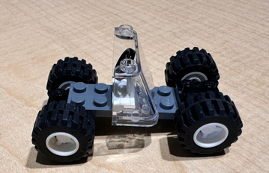




Description of Experimental setup
Run Down a Lego Made Car from a Ramp of fixed height and Measure distance it travels as various Design Factors were systematically changed
Car made of Legos
Ramp used to Run the Car down from
Location: McCord 330
Distance: From Ramp end to Car’s Front Tires
Measurement Tool: Ruler

Slide 8
Lego Car Project Deliverables
Project objectives and goals
Description of Experimental setup
Factors chosen and Rationale and Description of Factors
Test for Significance of Factors Effect (P value)
Response variable and Measurement
Choice of experimental design and experimental approach in general. How did you perform the experiment? How did you block any noise parameters etc.
Data Analysis and model adequacy checks, including residual analysis
Graph demonstrating the results from the experiments
Financial Analysis based on the design of the car and its performance
Final conclusion and recommendations

Slide 9




Factors Chosen – 4 Factors Included
Output Y = Distance Travelled by the Car
Factor
Symbol
Rational
A
Wheel Size effect the friction between wheels and table
Tire Size
Wind Screen Size
B
Wind Screen can effect the Air Resistance Car faces
Length of the Axle
C
Length effects the performance
Slant of Car
D
Center of Gravity shifts as the Slant changes

Slide 10
Low and High Levels of Factors
Low
High
A
Tire Size
Small
Large
Wind Screen Size
B
Small
Big
Length of the Axle
C
Short
Long
Slant of Car
D
Flat
Slanted

Slide 11
Lego Car Project Deliverables
Project objectives and goals
Description of Experimental setup
Factors chosen and a description of each factor
Test for Significance of Factors Effect (P value)
Response variable and Measurement
Choice of experimental design and experimental approach in general. How did you perform the experiment? How did you block any noise parameters etc.
Data Analysis and model adequacy checks, including residual analysis
Graph demonstrating the results from the experiments
Financial Analysis based on the design of the car and its performance
Final conclusion and recommendations

Slide 12
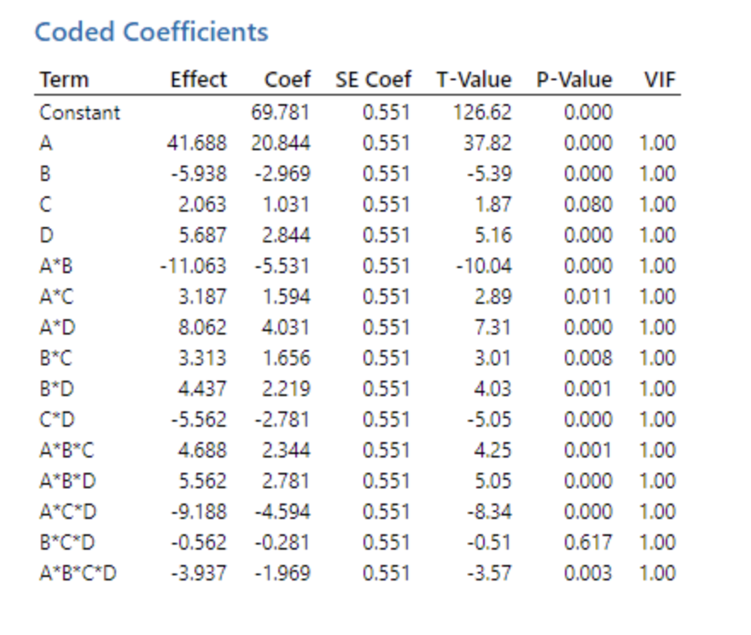
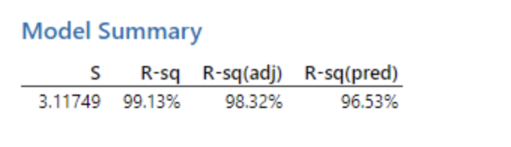
Test for Significance of Factors Effect (P value)
Key Takeaways
R-square - 99.13% of the variation within the dependent variable explained through model.
Adjusted R-square (98.32%) - high value of the R-square is not due to overfitting.
R-squared (96.53%) - shows the great predictive capability of the model for fresh data, while the standard error (S = 3.11749) is small, which means that the average prediction error is low, hence accurate.
C and BCD are considered to be not significant because their P-values > 0.05.

Slide 13
Lego Car Project Deliverables
Project objectives and goals
Description of Experimental setup
Factors chosen and a description of each factor
Test for Significance of Factors Effect (P value)
Response variable and Measurement
Choice of experimental design and experimental approach in general. How did you perform the experiment? How did you block any noise parameters etc.
Data Analysis and model adequacy checks, including residual analysis
Graph demonstrating the results from the experiments
Financial Analysis based on the design of the car and its performance
Final conclusion and recommendations

Slide 14
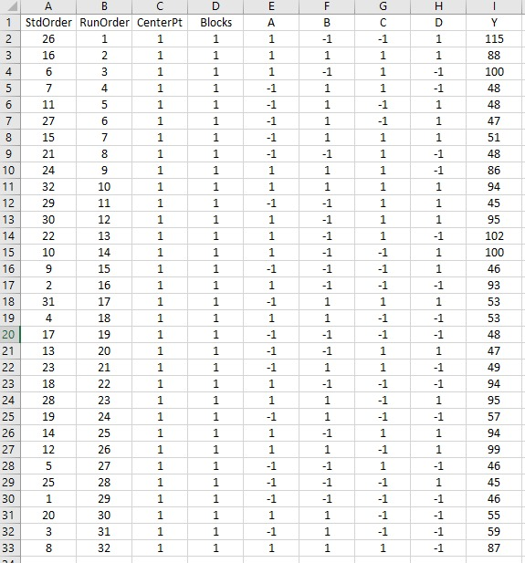
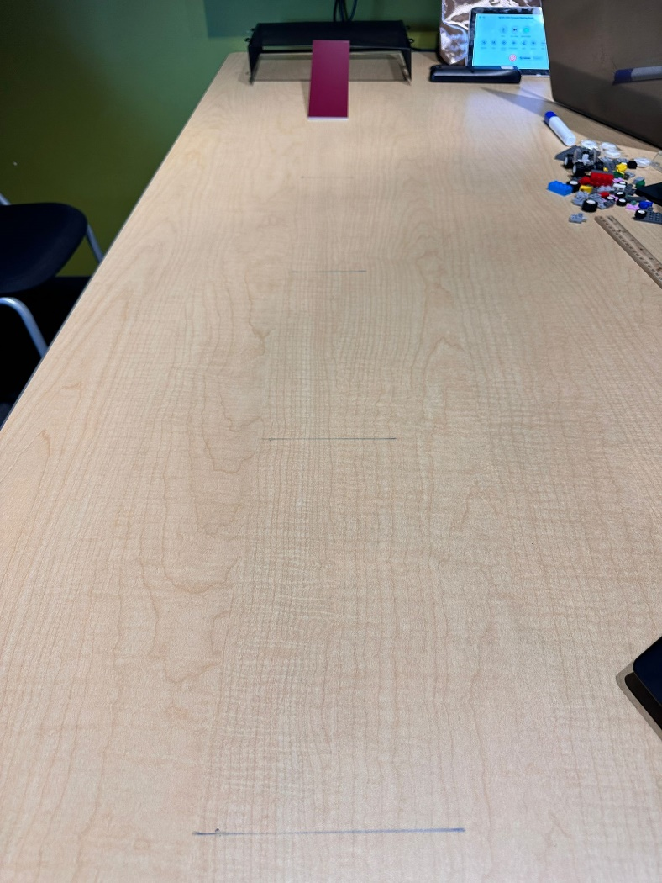
Response Variable Y and Measurement
Output Y = Distance Travelled by the Car

Slide 15
Lego Car Project Deliverables
Project objectives and goals
Description of Experimental setup
Factors chosen and a description of each factor
Test for Significance of Factors Effect (P value)
Response variable and Measurement
Choice of experimental Design and experimental approach in general. How did you perform the experiment? Blocking any noise parameters
Data Analysis and model adequacy checks, including residual analysis
Graph demonstrating the results from the experiments
Financial Analysis based on the design of the car and its performance
Final conclusion and recommendations

Slide 16



Lego Choice of the Experiment Design, Blocking Noise
Conducting Experiment:
Measured the distance from Ramp end to Front Tires
Data Collection and Analysis
Verification
Formed Test Matrix
Constructed Ramp
Made Measuring arrangements
Assembled Car as Per Test Matrix Configuration
Released Car from the top of Ramp
Choice of Experiment
Blocking Noise
Four Factors
Full Factorial
DOE
k = 4
n =2
Randomization of trials
Fixing/Taping the Ramp (5cm)
Marking down the measuring points
Controlled In door Environment (No wind, Temp Change)
Keeping Ramp Smooth and Clean

Slide 17
Lego Car Project Deliverables
Project objectives and goals
Description of Experimental setup
Factors chosen and a description of each factor
Test for Significance of Factors Effect (P value)
Response variable and Measurement
Choice of experimental Design and experimental approach in general. How did you perform the experiment? How did you block any noise parameters etc.
Data Analysis and model adequacy checks, including residual analysis
Graph demonstrating the results from the experiments
Financial Analysis based on the design of the car and its performance
Final conclusion and recommendations

Slide 18
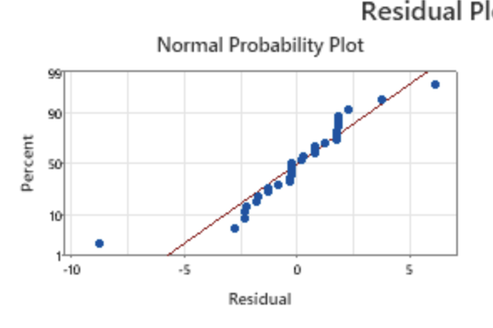
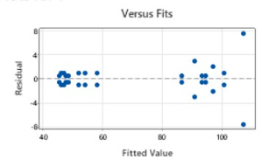
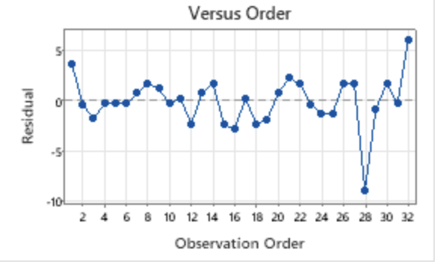
Residual analysis – Residuals are NID
Normal Probability Plot of residuals indicates that the residuals have a nearly linear pattern along the diagonal, which suggests that they are about normally distributed.
The plot of residuals versus order is randomly scattered. Residuals are independent and the model performs similarly across the dataset.
Versus Fits Residuals show random scatter around zero, indicating good model fit and no pattern in variance.

Slide 19
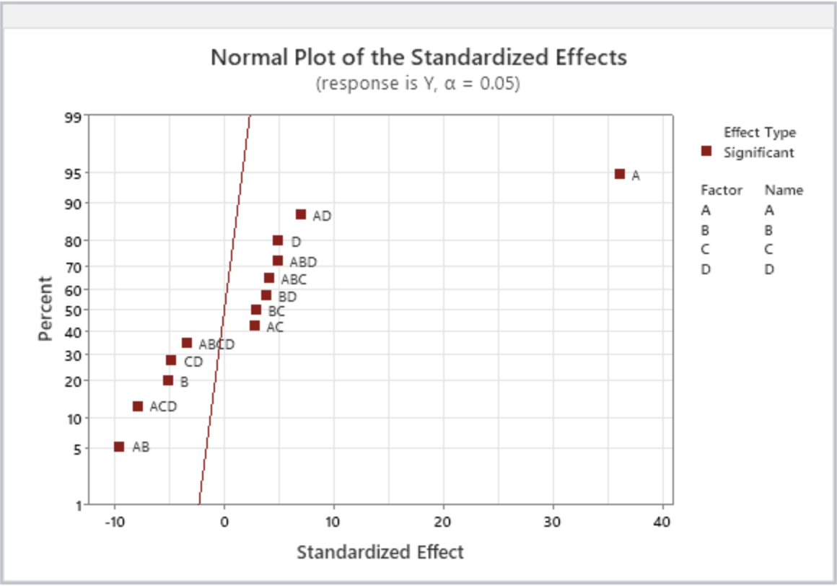
Effects Analysis through Normality Plot
Points that deviate substantially from the straight line-as would be the case for the factor **A** in this plot-are significant, meaning they have a profound influence on the response variable, whereas those points closer to the line are probably not significant.
Here, the most important factor is **A**, while other effects, such as AD, D, and ABD, have a small variance, meaning they are less important. The red line here is a baseline for detecting substantial effects.

Slide 20
Data Analysis and Factor Main Effects
Key Takeaways
Tire Size A has the most impact out of all the Factors taken into consideration
Wind Shield B has moderate but significant effect. Smaller the size of wind screen the further the car travels
Car Slant had bigger impact that the length of the car
Interactions among Factors significant signalling complex relationships among the Factors

Slide 21
Lego Car Project Deliverables
Project objectives and goals
Description of Experimental setup
Factors chosen and a description of each factor
Test for Significance of Factors Effect (P value)
Response variable and Measurement
Choice of experimental Design and experimental approach in general. How did you perform the experiment? How did you block any noise parameters etc.
Data Analysis and model adequacy checks, including residual analysis
Graph demonstrating the results from the experiments
Financial Analysis based on the design of the car and its performance
Final conclusion and recommendations

Slide 22
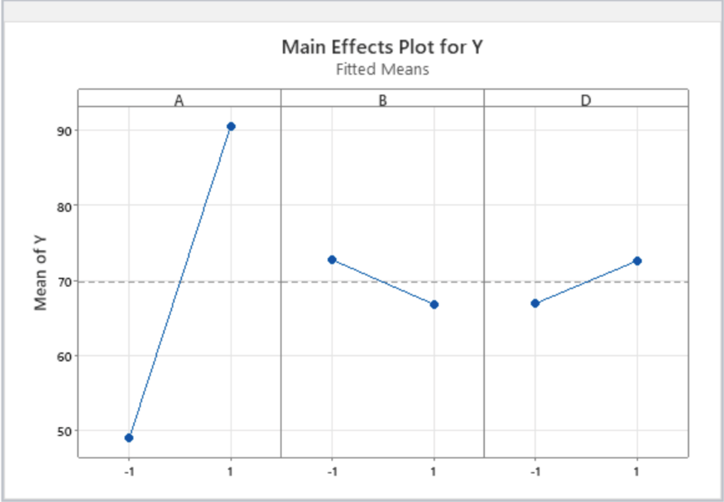
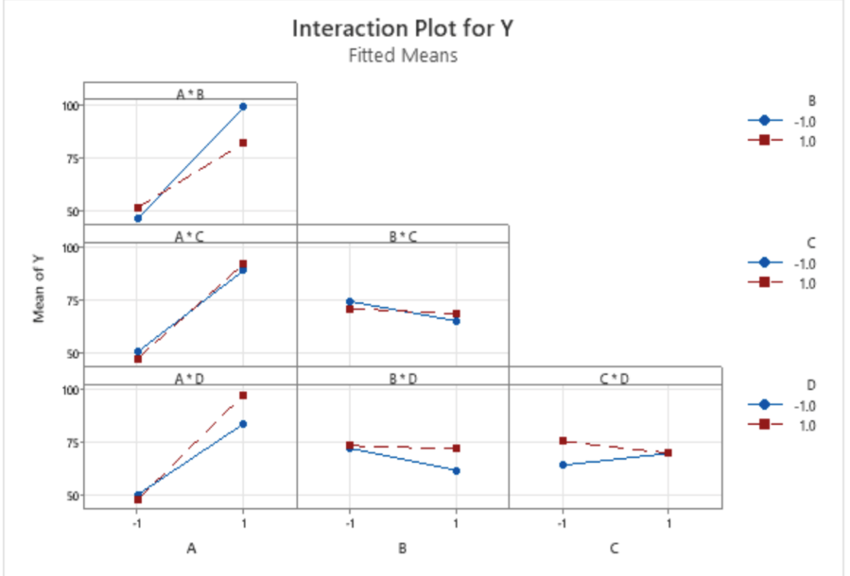
Graph demonstrating the results from the experiments
Interaction Effects Plot:
Summary of Interaction Effects
A * B (Wheel Size vs. Wind Screen Size):
At larger wheel sizes, a smaller wind screen significantly increases output, while a larger wind screen decreases it. For smaller wheel sizes, wind screen size has minimal impact on output.
A * C (Wheel Size vs. Length of Axle):
Larger wheel sizes combined with longer axles slightly improve output, while shorter axles have little effect. For smaller wheel sizes, axle length does not significantly affect output.
A * D (Wheel Size vs. Slant of Car):
Larger wheel sizes with a steep slant reduce output, while a lower slant improves it. For smaller wheel sizes, the slant has minimal impact.
B * C (Wind Screen Size vs. Length of Axle):
Wind screen size has little interaction with axle length as the effect is nearly constant. Longer axles slightly increase output compared to shorter ones.
B * D (Wind Screen Size vs. Slant of Car):
A smaller wind screen with a low slant results in better output than other combinations. Larger wind screens are less sensitive to changes in slant.
C * D (Length of Axle vs. Slant of Car):
Shorter axles combined with a low slant lead to slightly better performance than longer axles. The effect is small but consistent.

Slide 23
Lego Car Project Deliverables
Project objectives and goals
Description of Experimental setup
Factors chosen and a description of each factor
Test for Significance of Factors Effect (P value)
Response variable and Measurement
Choice of experimental design and experimental approach in general. How did you perform the experiment? How did you block any noise parameters etc.
Data Analysis and model adequacy checks, including residual analysis
Graph demonstrating the results from the experiments
Financial Analysis based on the design of the car and its performance
Final conclusion and recommendations

Slide 24
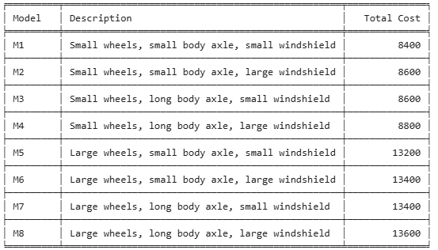
Financial Analysis based on the design of the car and its performance

Slide 25
Lego Car Project Deliverables
Project objectives and goals
Description of Experimental setup
Factors chosen and a description of each factor
Test for Significance of Factors Effect (P value)
Response variable and Measurement
Choice of experimental design and experimental approach in general. How did you perform the experiment? How did you block any noise parameters etc.
Data Analysis and model adequacy checks, including residual analysis
Graph demonstrating the results from the experiments
Financial Analysis based on the design of the car and its performance
Final conclusion and recommendations

Slide 26
Final conclusion and recommendations
Cost of the Best Model: 13,200
Best Performing Model: Large Tires 4x, Small Wind Screen with Slant and Small Axle
Experiment is Robust and generalizable: R Sq, Pred R Sq are high
Residuals are NID – No systemic bias
ns Cars with smaller wind screen and slant i.e smaller frontal area will experience less drag and have bigger wheel also reduces energy spent on friction will be more energy efficient

